Slide 1
API Design
Presentation of Assignment 2
E. Esati, S. Plüss, R. Prinz, B. Solenthaler

Slide 2
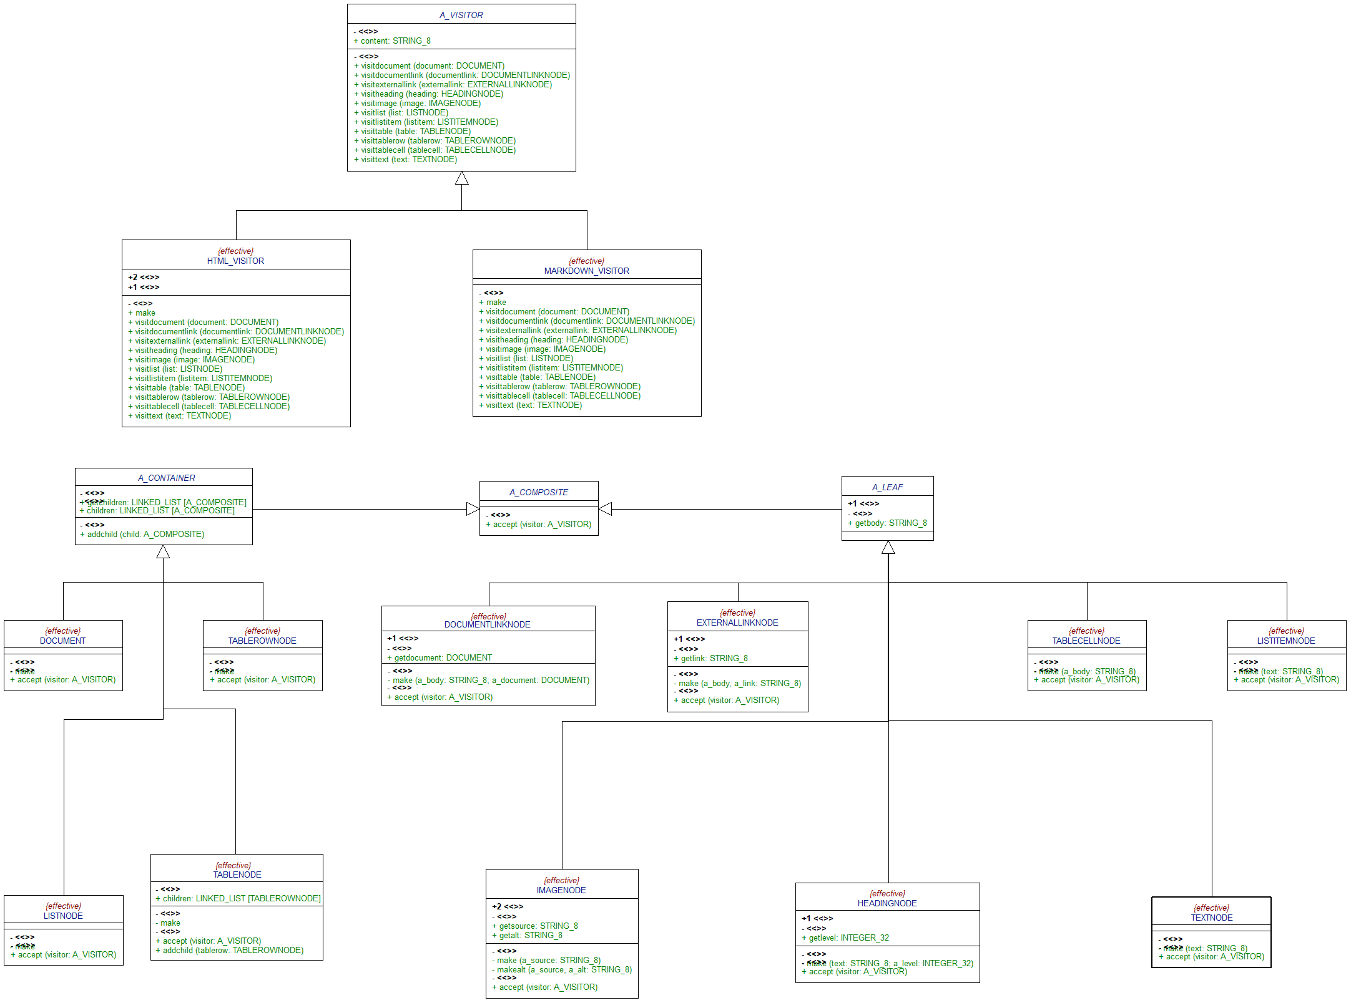
Visitor

Slide 3
Composite

Slide 4
Considered Patterns
Abstract Factory
Using the same classes does not need a factory
Possible: Builder
Outsourcing markup string generation from Visitor to a Builder

